Slide 1
Introduction to Deep Learning
Sungjoon Choi
Based on“Deep Learning Tutorial”by Yann LeCun
and other various sources.

Slide 2

What is Deep Learning?
Wikipedia says:
“Deep learning is a branch of machine learning based on a set of algorithms that attempt to model high-level abstractions in data by using multiple processing layers, with complex structures or otherwise, composed of multiple non-linear transformations.”
High-level
abstraction
Machine
Learning
Network

Slide 3
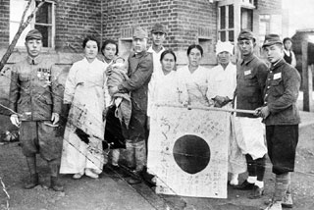
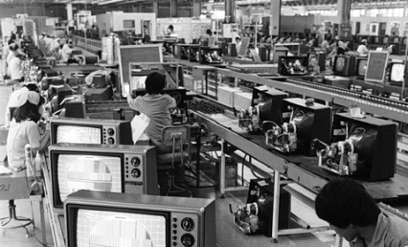
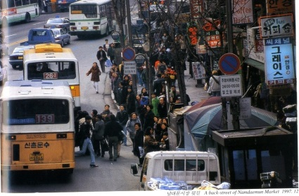
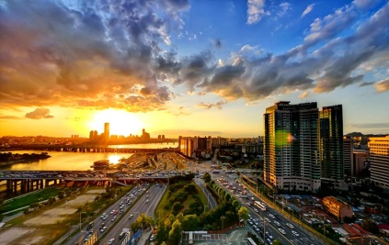
Is it Brand New?
Neural Nets
McCulloch & Pitt 1943
Perception
Rosenblatt 1958
RNN
Grossberg 1973
CNN
Fukushima 1979
RBM
Hinton 1999
DBN
Hinton 2006
D-AE
Vincent 2008
AlexNet
Alex 2012
GoogLeNet
Szegedy 2015

Slide 4

Learning Representation
ML/AI: how do we learn features?
What is the fundamental rule?
What is the learning algorithms?
Trainable Feature Transform
Neuroscience: how does the cortex learn perception?
Trainable Feature Transform
CogSci: how does the mind learn abstract concepts on top of less abstract ones?
Deep learning addresses the problem of learning hierarchical representation with a single algorithm.

Slide 5
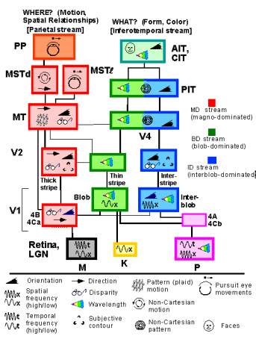
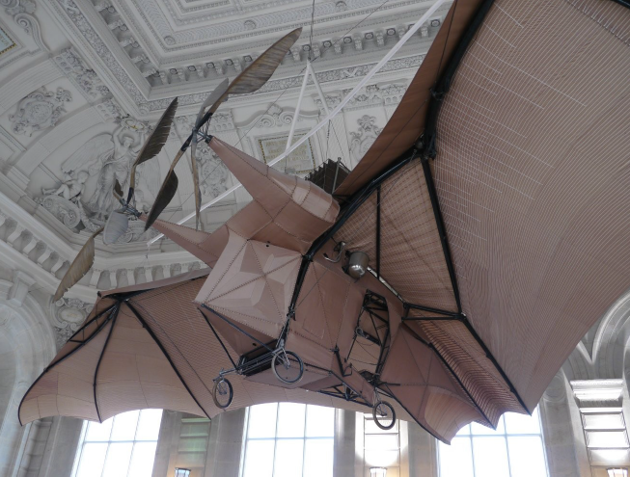
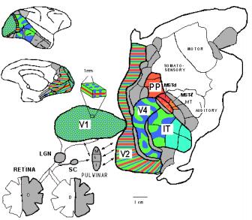

Inspired by Nature?
L'Avion III de Clement Ader, 1897
Sure there is some resemblance!
But, do not go TOO FAR.

Slide 6
Four Types of Deep Architectures
Feed-Forward: multilayer neural nets, convolutional nets
Feed-Back: Stacked Sparse Coding, Deconvolutional Nets
Bi-Directional: Deep Boltzmann Machines, Stacked Auto-Encoders
Recurrent: Recurrent Nets, Long-Short Term Memory

Slide 7
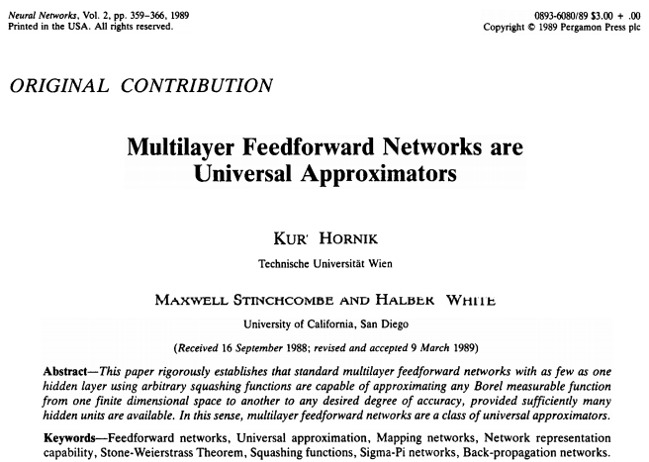
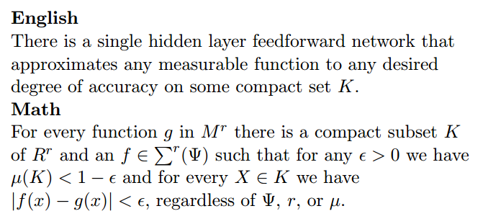
BTW, do we really need deep?
Cited > 12,000

Slide 8
BTW, do we really need deep?
Deep machines are more efficient for representing certain classes of functions, particularly those involved in visual recognition.
In other words, they can represent more complex functions with less “hardware”.
In fact, it works out perfectly in a number of competitions.
The researchers say even they weren’t sure this new approach (152 layers!) was going to be successful – until it was.
“We even didn’t believe this single idea could be so significant,”
said Jian Sun, a principal research manager at Microsoft Research
http://blogs.microsoft.com/next/2015/12/10/microsoft-researchers-win-imagenet-computer-vision-challenge/

Slide 9

Is it Omnipotent?

Slide 10
Applications

Slide 11
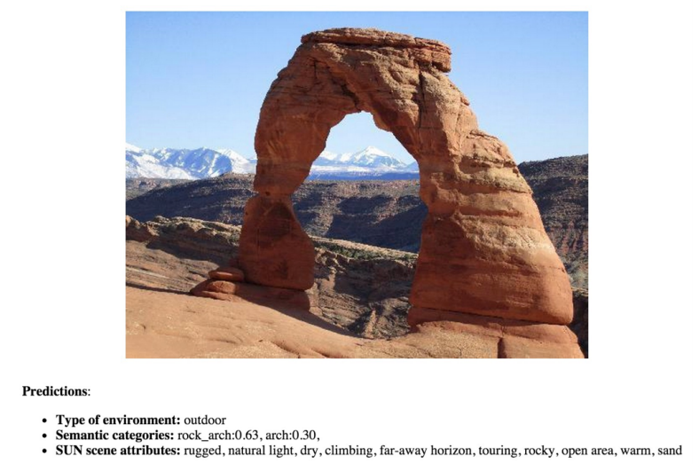
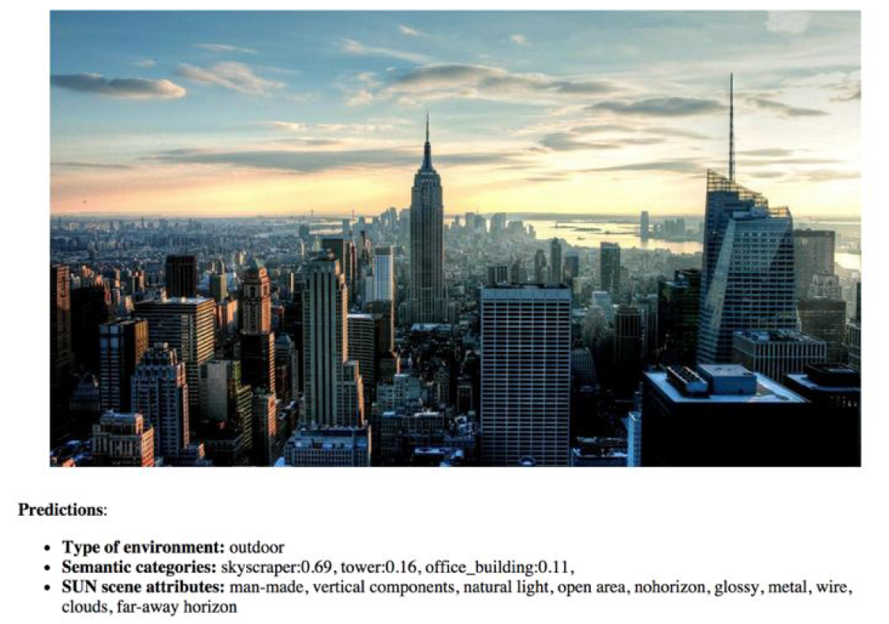
Scene Recognition (CNN)
B. Zhou, A. Lapedriza, J. Xiao, A. Torralba, and A. Oliva. “Learning Deep Features for Scene Recognition using Places Database.” Advances in Neural Information Processing Systems 27 (NIPS), 2014.

Slide 12
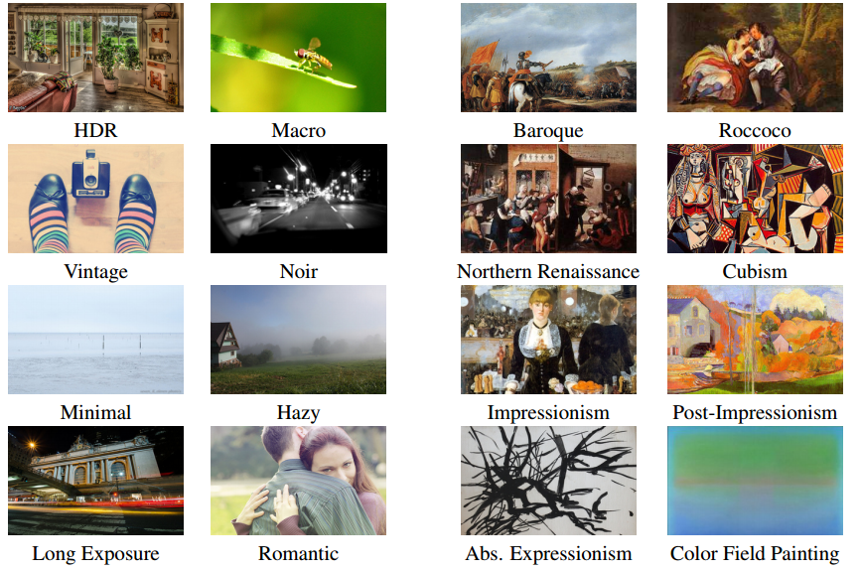
Visual Style Recognition (CNN)
Karayev, Sergey, et al. "Recognizing image style." arXiv preprint arXiv:1311.3715 (2013).

Slide 13
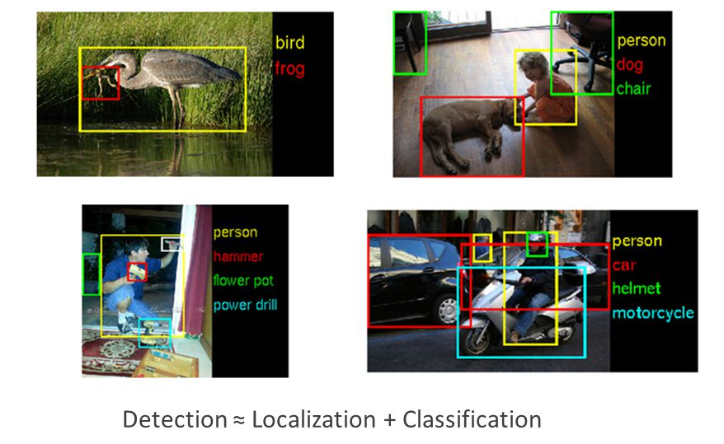
Object Detection (R-CNN)
Girshick, Ross, et al. "Region-based convolutional networks for accurate object detection and segmentation." Pattern Analysis and Machine Intelligence, IEEE Transactions on 38.1 (2016): 142-158.

Slide 14
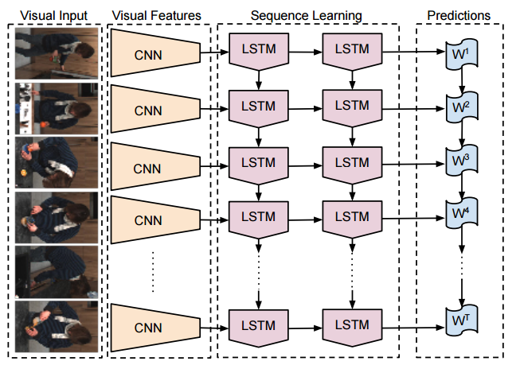
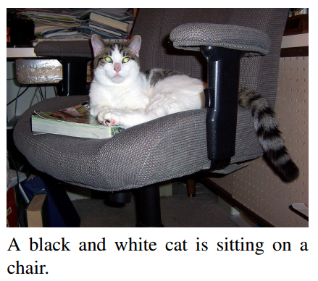
Image Captioning (CNN+LSTM)
Donahue, Jeffrey, et al. "Long-term recurrent convolutional networks for visual recognition and description." Proceedings of the IEEE Conference on Computer Vision and Pattern Recognition. 2015.

Slide 15
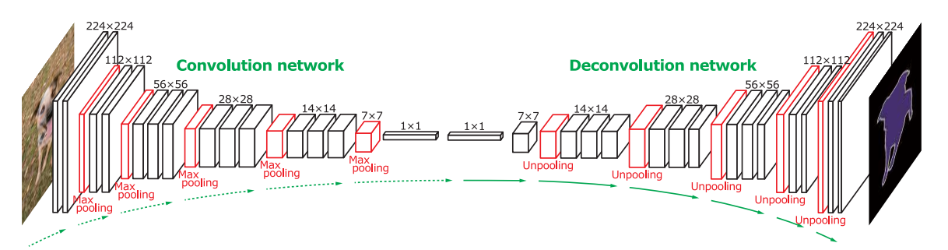
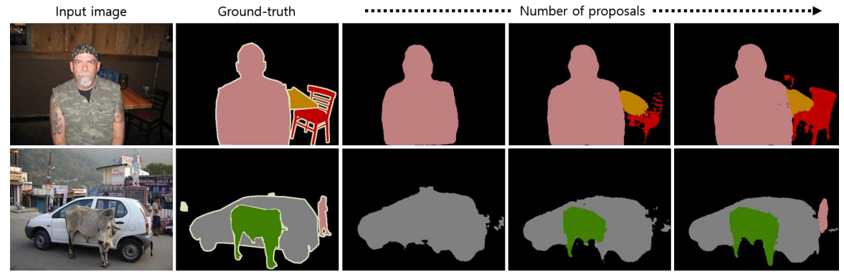
Segmentation (DeconvNet)
Hyeonwoo Noh, Seunghoon Hong, Bohyung Han, Learning Deconvolution Network for Semantic Segmentation, arXiv:1505.04366.

Slide 16
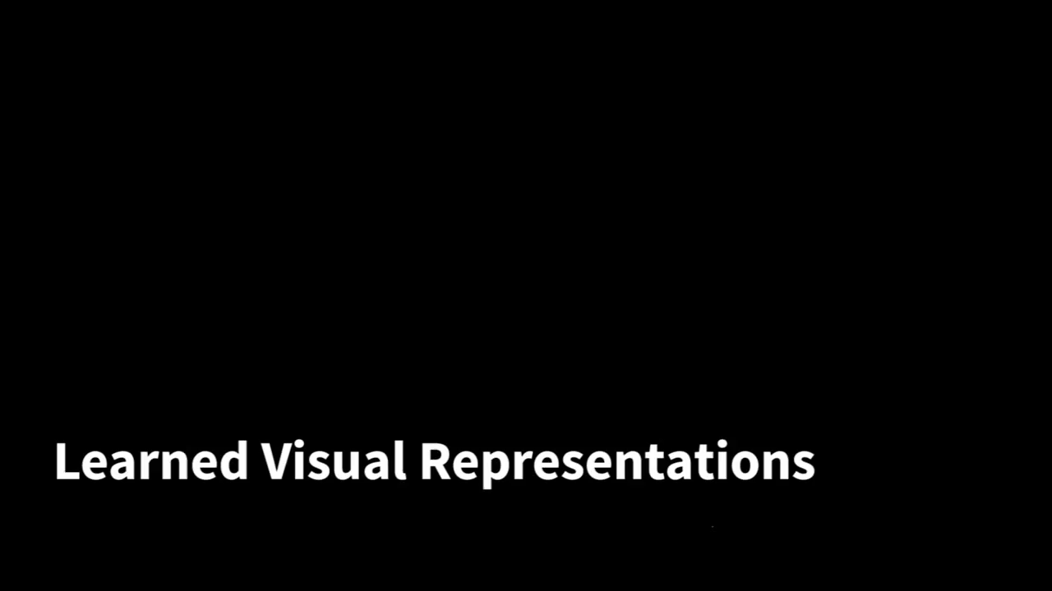
Deep Visuomotor Control (CNN)
Levine, Sergey, et al. "End-to-end training of deep visuomotor policies." arXiv preprint arXiv:1504.00702 (2015).

Slide 17
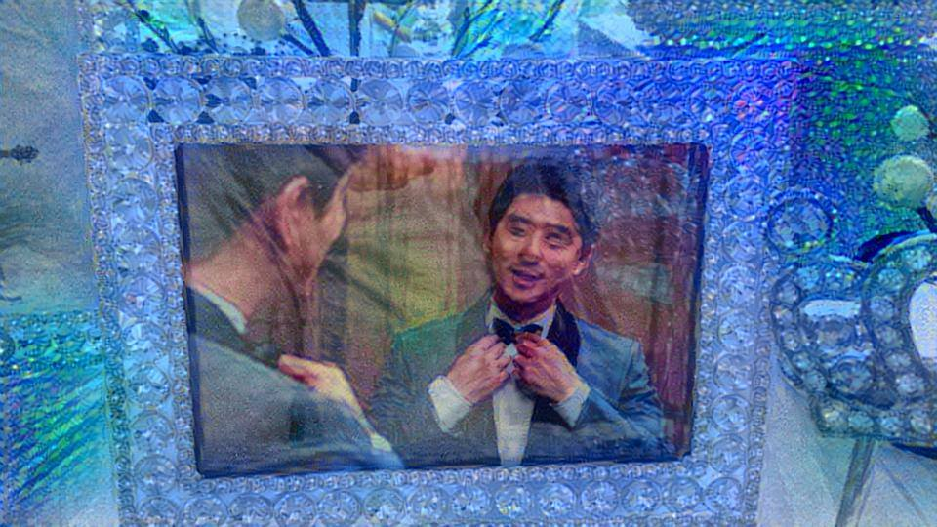
Neural Style (CNN)
Gatys, Leon A., Alexander S. Ecker, and Matthias Bethge. "A neural algorithm of artistic style." arXiv, 2015

